Slide 1
YouTube Trending Videos Analysis
^{By:}
^{Name : S.Lakshmi}
^{Degree : BE}
^{Branch :CSE}
College : PET Engineering College
^{NM ID : au963221104026}
Email ID : lakshmilaks335@gmail.com

Slide 2
OUTLINE
✧ Problem Statement
✧ Proposed System/Solution
✧ System Development Approch
✧ Algorithm & Deployment
✧ Result
✧ Conclusion
✧ References

Slide 3
PROBLEM STATEMENT
✧Problem Statement :
-The main goal of this study is to analyze the factors that influence popular YouTube video
✧Methodology :
- Analyze the published time of all videos and sort in 24 hours to understand when is popular hour to publish videos.
- Utilize number of comments and views to calculate how people interact with the youtuber
⁠✧Objectives :
- To understand characteristics that makes a video end up in trending section on YouTube.
- By increasing subscriber count and views this can help you youtuber’s to earn more money,sponsorships and opportunities to excel in their social media carrier

Slide 4
PROPOSED SOLUTION
✧Data Collection :
- Utilize YouTube Data API to fetch data on trending videos by region, category, view count, likes, comments, etc. ✧Data Preprocessing : - Clean the data by handling missing values, removing duplicates, and standardizing the format. - Extract relevant features such as the title, description, views, likes, dislikes, comments, etc.
⁠✧Exploratory Data Analysis (EDA) : - Conduct EDA to understand trends, patterns, and correlations in the data. - Analyze popular video categories, engagement metrics, and temporal trends.

Slide 5
PROPOSED SOLUTION-CONT.
✧Feature Engineering: - Create new features like engagement rate (likes/views), comment sentiment analysis, etc. - Derive insights by categorizing videos based on textual data (title, description).
⁠✧Sentiment Analysis :
- Perform sentiment analysis on comments to gauge audience sentiment towards trending videos. - Identify topics or themes that positively or negatively impact video popularity. ⁠✧Deployment: - Deploy the solution as a service or integrate it into a web application for real-time trending video analysis. - Continuously update the model with new data to adapt to changing trends

Slide 6
SYSTEM APPROACH
✿ System Requirement :
✧ Requirement Analysis : - Define the objectives and scope of the analysis. - Identify key stakeholders and their requirements. - Determine the metrics to measure video trends.
✧ Feedback and Iteration : - Collect feedback from users and stakeholders on the system performance. - Iterate on the system based on feedback and changing requirements. - Continuously improve the system for enhanced analysis capabilities.

Slide 7
SYSTEM APPROCH-CONT.
✧ Scikit-learn (sklearn) : Scikit-learn is considered the most prominent Python library for machine learning and depends on two other Python packages, Numpy and SciPy (5). ⁠✧ OS : The OS module in Python provides a way of using operating system dependent functionality. ⁠✧ Pandas : This is a Python library for data wrangling and analysis.This library is mainly used in data pre-processing.
⁠✧ Numpy : This is one of the fundamental packages for scientific computing in Python. ✧ Scipy : It provides, among other functionalities, advanced linear algebra routines, mathematical functions, and statistical distributions. ⁠✧ Matplotlib : It provides functions for making publication-quality visualizations such as line charts, histograms, scatter plots. ✧ Seaborn : This is a library for making statistical graphics in Python.

Slide 8
ALGORITHM AND DEPLOYMENT
⁠✧ Classification :
- It is a process of creating classes that represent users and use cases.
- Class Probability Estimation tries to predict how to classify each single individual data asset. ✧ Regression:
- The most commonly-used forecasting method is the Regression method.
- Regression can be confused with classification methods because to predict an outcome, the process of using known values is the same.
- It is a model used to predict continuous value.

Slide 9
ALGORITHM AND DEPLOYMENT-CONT
⁠✧ Clustering:
- Clustering is a technique which involves grouping of data points.
- We can use this algorithm for classification of each datapoint into a specific group.
- The datapoints which are grouped will have similar features while those are in different groups will have highly dissimilar features.
✧ Similarity Matching :
- Similarity Matching looks for correlation of attributes in order to recognize similarities between individuals.
- If two customers or products are similar in certain ways, it’s reasonable to predict that they will be similar in other ways as well.
- This can be used to find customers for targeted marketing campaigns or for managing the company’s image with targeted online ads.

Slide 10
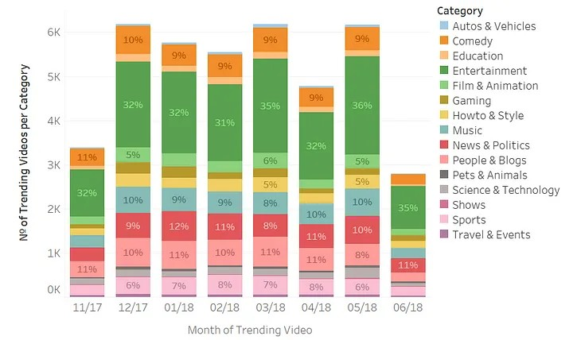
RESULT

Slide 11
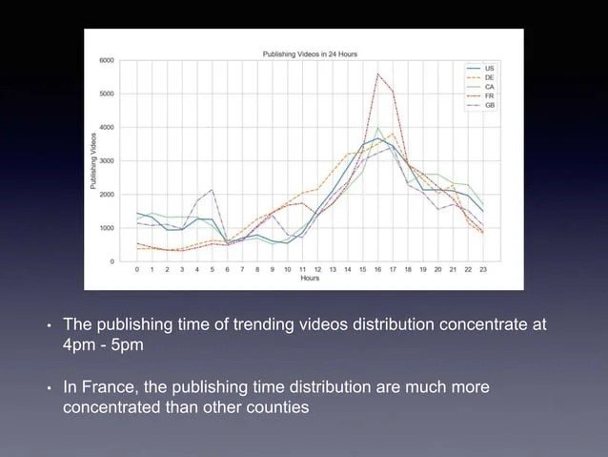
RESULT-CONT.

Slide 12
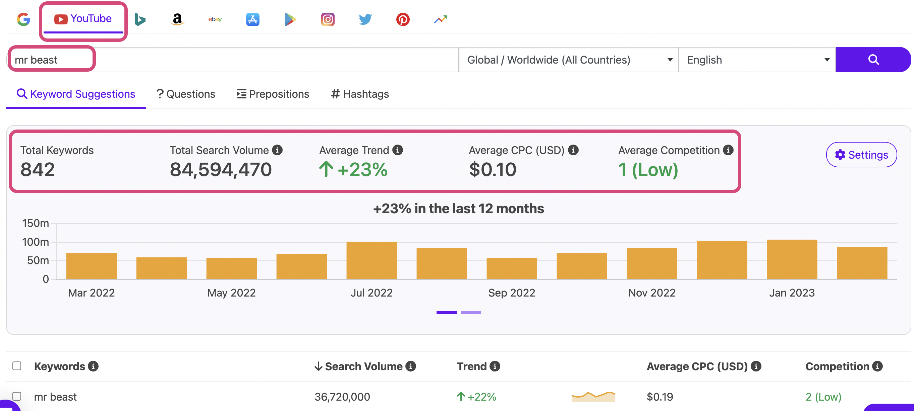
RESULT-CONT.

Slide 13
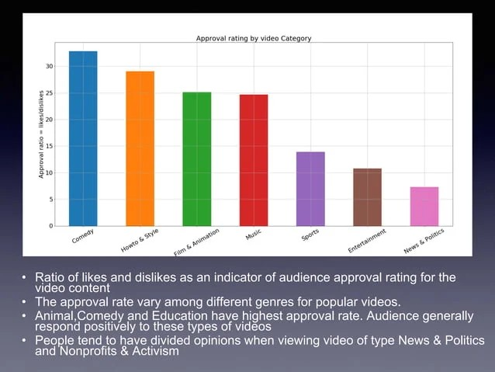
RESULT-CONT.

Slide 14
CONCLUSION
In this paper, we presented our findings for measuring, analyzing, and comparing key aspects of YouTube trending videos. To know only best time to upload a video on YouTube is not enough to generate a millions of views for your Videos to become trend. There are some other factors to considered are Good Titles, Good thumbnails, Video SEO, proper tagging, and the number of subscribers are all factors that is a key generating views for your content. Understanding this Statistics will not only help YouTube to develop better algorithms to process videos but also benefit to make decisions for individual youtubers.

Slide 15
REFERENCES
https:// keywordtool.io/blog/youtube-trends/
https://www.searchenginejournal.com/youtube-algorithm
https://www.researchgate.net/publication/266262149_Tre
https://www.slideshare.net/diljitnayak1/youtube-trending-videospptx

